Slide 1
Factors That Drive House Prices
Md Sharif Mia

Slide 2
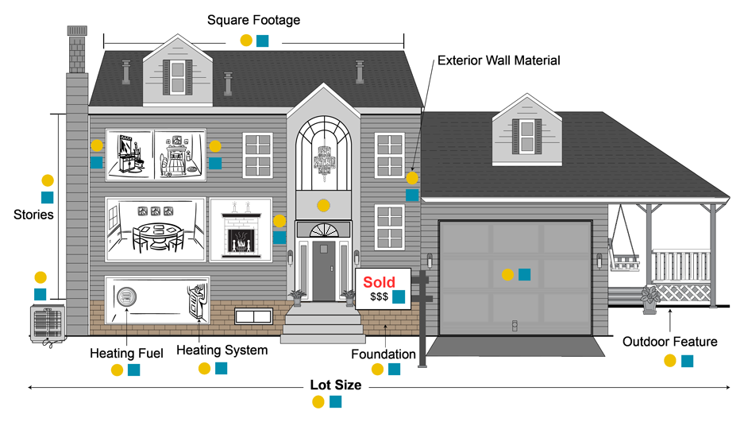
Situation
How should team allocate dollars into mortgage-backed securities?
What are the factors that drive house prices?
Define: Mortgage-backed securities
Bonds that represent an investment in a group of home loans
Formed when lending banks bundle their mortgages into pools and sell them to investment banks or government agencies in the form of a bond
Allows investors to benefit from the mortgage business without having to buy or sell an actual home loan
Definition Source: My Accounting Course

Slide 3
Data Analyzed
Sample size: 1460 houses
Location: 25 neighborhoods in Ames, Indiana
Highest sale price: $755,000; Lowest sale price: $34,900
Data set included: 79 categories of housing features (e.g. lot area, foundation type, etc.)
Assumptions Made
Investments will be made in Ames, Indiana
Mortgage-backed securities will be bought on a monetarily tiered system

Slide 4
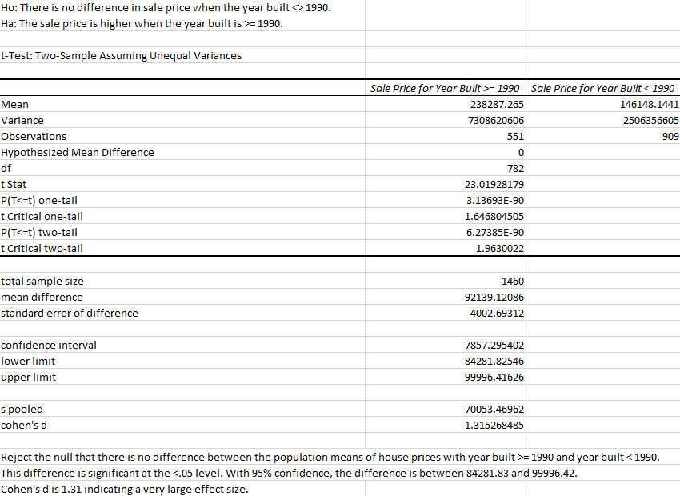
Statistical Analysis

Slide 5
Top 3 Factors

Slide 6
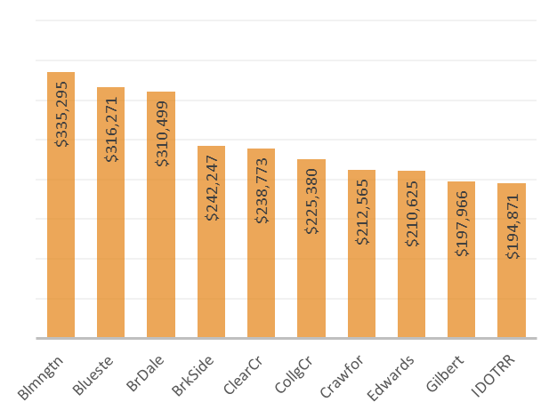
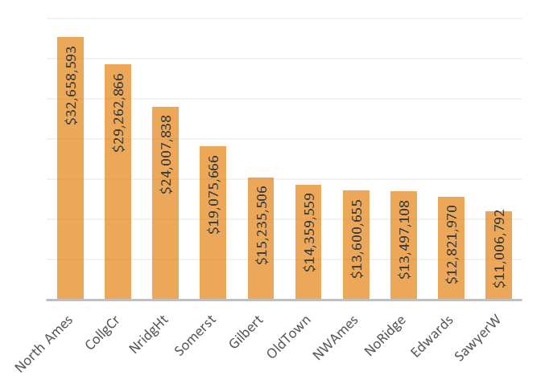
#1: Neighborhood
Neighborhoods with a higher number of houses sold drive greater profits
Bloomington Heights has the highest average sales price but North Ames has the highest sum of sales
As total profit is the goal, consider investing in neighborhoods that sell the highest total number of houses
Avg. Sale Price (Top 10)
Total Sale Price (Top 10)

Slide 7

#2: Year Built & Remodeled
There is a 63% increase in average sale price for houses built since 1990
Houses sold as “new” have a 60% higher sale price on average
When a house has been remodeled since 2000, it sells for 38% higher on average

Slide 8
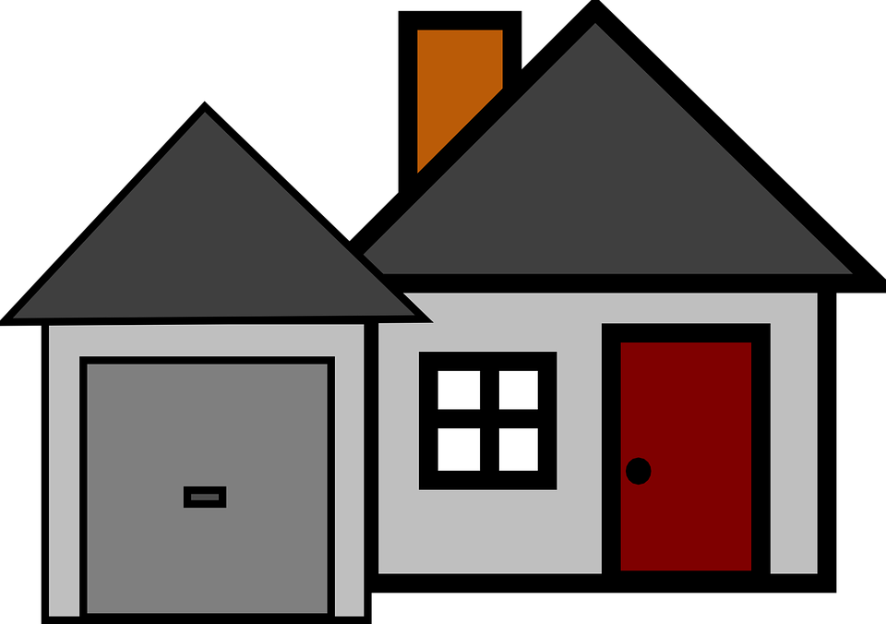
#3. Size of House & Lot
Houses with a lot area of 10,000+ square feet had an average sale price of $217k, compared to houses with smaller lot areas with an average sale price of $154k
Houses with an above ground living area of 1500+ square feet sell for $100k more than houses with less square feet
A house with a garage capacity of 3+ cars sold for 83% more than a garage capacity of 1-2 cars
Ground Living Area = 1500+ square feet
Garage Capacity = 3+ cars
Lot Area = 10,000+ square feet

Slide 9
Checklist Tool

Slide 10
Categorical Data Analyzed for Checklist
Physical Attributes
Foundation
Basement Exposure
Garage Type
Amenities
Paved Drive
Number of Fireplaces
Central Air
Fencing
Location
Lot Configuration
Neighborhood
Size
Rooms Above Grade
Lot Area
Lot Frontage
Above Grade Living Area Square Feet
Garage Capacity
Housing Parameters
Sale Condition
Year Built
Density Level
Type of Sale
Type of Dwelling
Year Remodeled

Slide 11
House Profitability Checklist
GOOD
Low density zone
Has central air
Paved driveway
BETTER
Year built > 1990
Poured concrete foundation
Attached garage
BEST
Type of sale is “new”
Garage capacity is 3+ cars
Low density zone
Has central air
Paved driveway
Year built > 1990
Poured concrete foundation
Attached garage
Low density zone
Has central air
Paved driveway
Average Sale Price
$187,875
$204,839
$226,309

Slide 12
Mortgage-Backed Securities Tier Recommendation

Slide 13
Tier Recommendation
Houses valued between $100k and $250k
Houses valued over $250k
Houses less than $100k
There are 3 times as many houses sold in the $100-$250k mid-range than in both other ranges combined
This mid-range sale price is recommended for most profitable mortgages to target due to sheer quantity of houses

Slide 14
Next Steps

Slide 15
Next Steps to Consider
Expand dataset for further insights
Monthly mortgage payments for each house, timely mortgage payments, etc.
Gather more information on mortgage-backed securities in Ames, Indiana or other towns with similar demographics
Look into bundling options – are there any?
Reach out to other investment firms to consider partnership

Slide 16
THANK YOU!

